Slide 1








Tree Sense — Shortest Path
An interactive FastAPI-based tool for computing optimal paths in images using A* search algorithm
Interactive Pathfinding visualization
Report Date: 2025-11-12

Slide 2

















What is Tree Sense?
Tree Sense is an interactive FastAPI-based tool that enables users to find the shortest or lowest-cost paths on uploaded aerial or ground images.
Powerful Backend
Built using the FastAPI framework, providing a robust foundation for pathfinding tasks
A* Search Algorithm
Leverages the efficient A* search algorithm to compute optimal paths
User-Friendly Interface
Provides a simple web interface for uploading images and marking points
Output
Static Summary Image
Search Animation
Tree Sense — Shortest Path

Slide 3















Key Features
Image Upload
Interactive Selection
Grid Conversion
Supports uploading PNG/JPG images through a simple web user interface for pathfinding tasks
Allows users to interactively select start, goal, waypoint, and obstacle points directly on uploaded images
Automatically converts input images into traversable grids using dark-pixel threshold detection
Configurable A*
Output Generation
Data Storage
Implements A* search with customizable parameters: 4- or 8-neighbor movement and Manhattan/Euclidean heuristics
Produces static summary images and MP4/WebM animations visualizing the A* search process
Stores all generated artifacts and data for each image under a designated `data/` directory
Tree Sense — Shortest Path

Slide 4



















User Workflow
The user interaction with Tree Sense follows a straightforward, step-by-step process:
1. Upload Image
2. Mark Points
3. Configure & Run
4. View Results
Upload a PNG or JPG image via the web interface
Mark start, goal, waypoints, and obstacles on the image
Set A* parameters (4- or 8-neighbor, heuristic type)
Get path summary and search animation
Outputs
Static Path Image
Search Animation
Tree Sense — Shortest Path

Slide 5



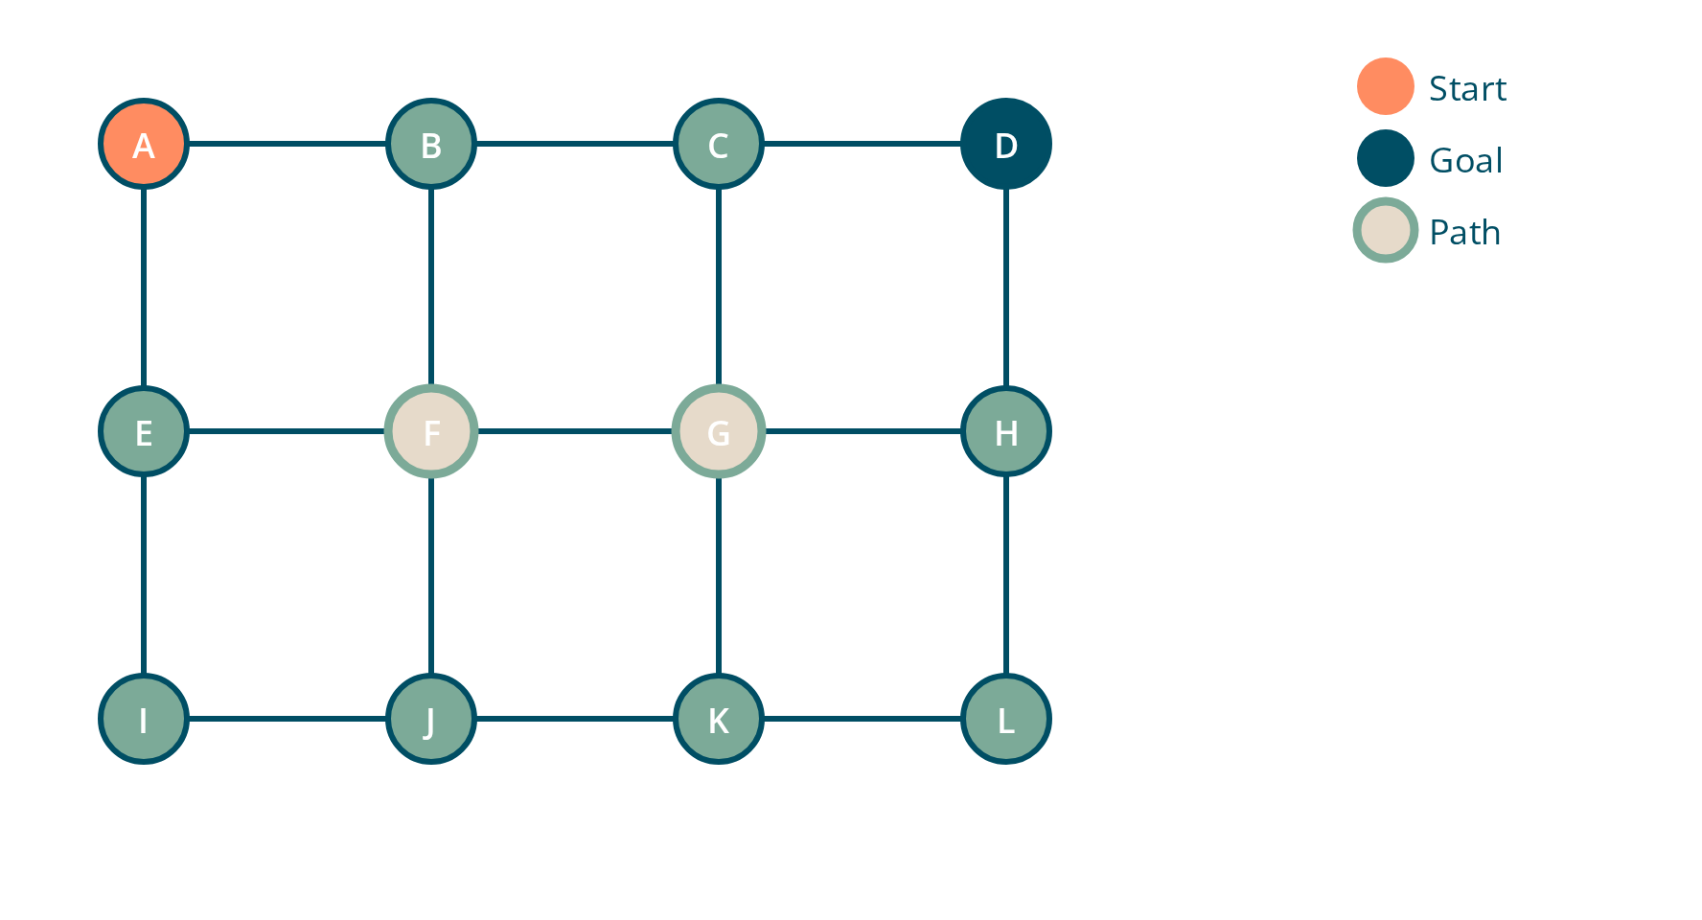






Mathematical Foundation - Grid as Weighted Graph
The environment (aerial/ground image) is conceptualized as a weighted graph:
Graph Representation
G = (V, E)
V = Set of all valid pixels/grid cells (vertices)
E = Set of edges connecting neighboring pixels
c(u, v) = Cost function - effort to move from pixel u to v
4-Neighbor vs 8-Neighbor
Path Cost Function
4-Neighbor: Up, Down, Left, Right
8-Neighbor: 4-Neighbor + Diagonals
C(P) = ∑i=1 c(vi-1, vi)
Manhattan distance
Minimize cost: minP∈ℙ(s,g) C(P)
Euclidean distance
Tree Sense — Shortest Path

Slide 6



















Path Definition and Optimization
Path Definition
A path P is a sequence of connected nodes:
P = (v₀, v₁, v₂, ..., vₖ)
Where:
v₀ = s (start node)
vₖ = g (goal node)
(vᵢ₋₁, vᵢ) ∈ E (connected nodes)
Optimization Objective
A* aims to solve the optimization problem:
minₚ∈ℙ(s,g) C(P)
Where the total travel cost is:
Key Concepts
C(P) = ∑ᵢᶜ(vᵢ₋₁, vᵢ)
ℙ(s,g) represents all possible valid paths from start to goal
Connected Nodes
Cost Minimization
Tree Sense — Shortest Path

Slide 7


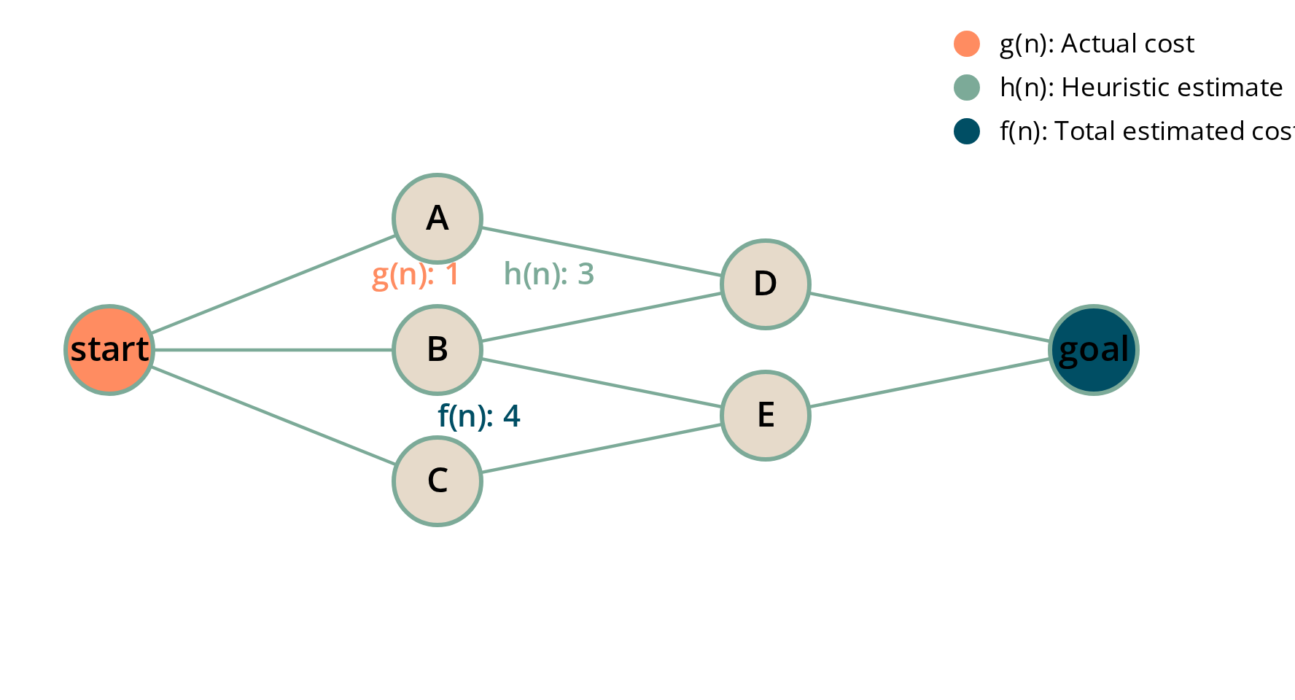




A* Algorithm Core Components
g(n)
The actual cost from the start node to the current node. Represents the "known" part of the journey.
h(n)
The estimated cost from the current node to the goal node. This is an "informed guess" provided by a heuristic function.
f(n)
The total estimated cost of the path from the start node to the goal node if it passes through the current node.
How A* Uses These Functions
f(n) = g(n) + h(n)
A* prioritizes nodes with the lowest f(n) value, balancing the actual cost traveled (g(n)) with the estimated remaining cost (h(n)).
Tree Sense — Shortest Path

Slide 8































A* Algorithm Initialization and Main Loop
Initialization
OPEN List
CLOSED List
Set g(s) = 0 (cost to reach start node is 0)
Node s: f(s)=h(s)
Node n
Calculate f(s) = h(s) (estimated total cost)
Sorted by f(n) value
Visited nodes
Initialize OPEN list with start node (f(s), s)
Initialize CLOSED list as empty
Main Loop
While OPEN list is not empty:
Select best candidate node n (lowest f(n))
If n is goal, terminate and reconstruct path
Move n from OPEN to CLOSED
Expand neighbors and update costs
Tree Sense — Shortest Path | Page 8

Slide 9



















Path Reconstruction and Optimality
Path Reconstruction
Optimality Conditions
After reaching the goal node, the optimal path is reconstructed by backtracking using parent pointers.
A* guarantees an optimal path if the heuristic function satisfies these conditions:
Start with the goal node
Admissibility
P = [g]
The heuristic never overestimates the true minimal cost:
Trace back parents
P = P ∪ {parent(g)} until s is reached
h(n) ≤ h*(n) ∀ n ∈ V
Reverse to get final path
"The heuristic never overestimates."
P = [s, ..., g]
Consistency
The estimated cost never decreases faster than real travel cost:
h(n) ≤ c(n, m) + h(m) ∀ (n, m) ∈ E
S
P
"Estimated cost never decreases faster than real travel cost."
P
G
Tree Sense — Shortest Path

Slide 10


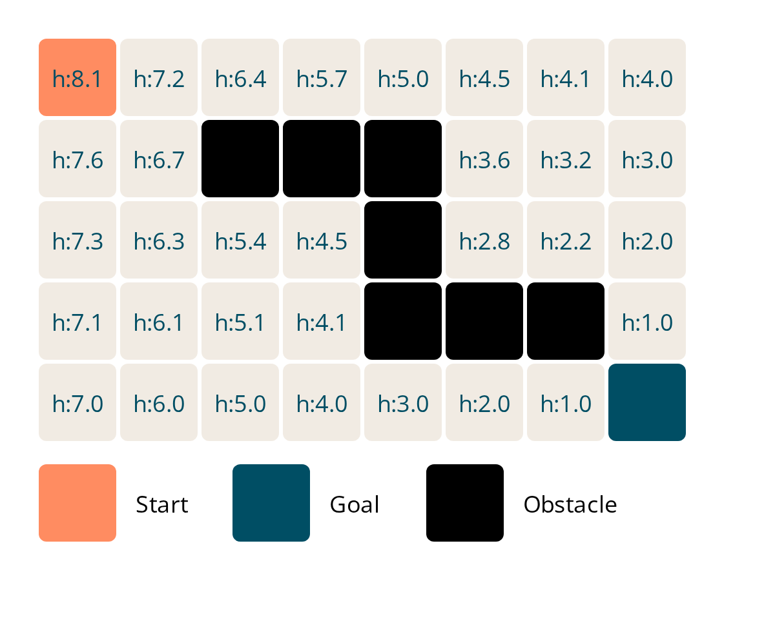








Geometric Intuition and Cost Balance
At every step, A* minimizes the function f(n) = g(n) + h(n), balancing actual travel cost with estimated remaining distance.
g(n): Actual Cost
"How far we have traveled so far." The known part of the journey.
h(n): Estimated Cost
"How far we think we still need to go." Provided by the heuristic function.
f(n): Total Cost
"Total predicted effort from start to goal through this node."
Cost Function Terms
g(n)
+
h(n)
f(n)
Actual cost
Heuristic cost
Total cost
Tree Sense — Shortest Path

Slide 11


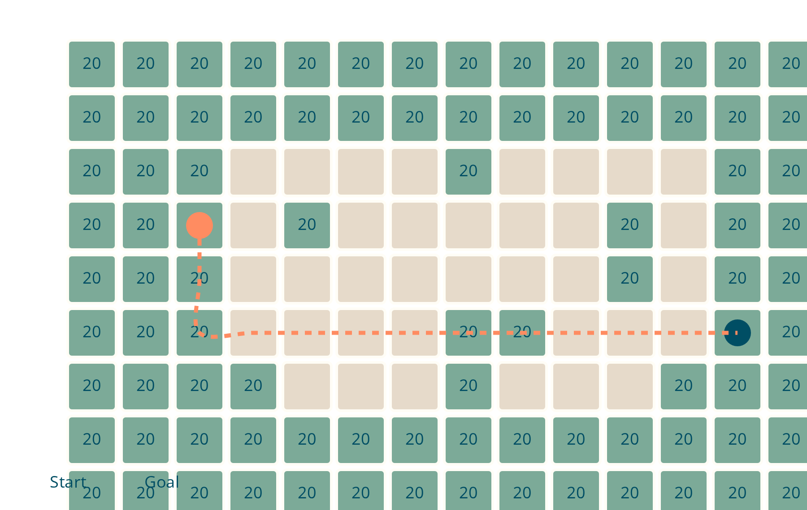








Vegetation Cost Example
In Tree Sense, each pixel has a traversability cost that influences the pathfinding algorithm:
Open ground: cost 1
Vegetation: cost 20
Cost Impact on A* Algorithm
Paths through dense vegetation have higher g(n) values
A* prioritizes paths with lower f(n) = g(n) + h(n) values
Algorithm will only navigate through dense trees if it's the only viable route
Cost Calculation Example
20 + 20 = 40
1 + 20 = 21
Vegetation to vegetation: cost 20
Open ground to vegetation: cost 21
Tree Sense — Shortest Path

Slide 12






























A* vs Other Algorithms
Search Space Exploration
Dijkstra's Algorithm
A* Algorithm
Greedy Best-First
Complete
Complete
Optimal
Fast
Optimal
Efficient
Not Optimal
Slow
Minimizes g(n) + h(n)
Incomplete
Minimizes g(n) only
Minimizes h(n) only
Key Advantages of A*
Blends the benefits of both algorithms, creating a powerful hybrid approach
Finds optimal paths efficiently by using heuristics to guide search
Mathematical compromise between Dijkstra's and Greedy approaches
Dijkstra
A*
Greedy
Expands outward in all directions
Balances exploration and exploitation
Prioritizes nodes near the goal
Tree Sense — Shortest Path

Slide 13








Conclusion and Future Work
Tree Sense Summary
Future Enhancements
Tree Sense provides an interactive, FastAPI-based solution for computing shortest or low-cost paths on aerial or ground images.
Enhanced Visualization
Multi-Layer Support
Graph Modeling
Improved interactive maps and real-time path highlighting
Processing of layered images with semantic segmentation
Images are represented as weighted graphs, transforming pathfinding into an optimization challenge
A* Algorithm
Efficiently finds optimal routes by balancing actual costs with heuristic estimates
Machine Learning Integration
Cloud Deployment
Scalable cloud infrastructure for large-scale deployments
User Experience
Adaptive cost functions based on learned terrain preferences
Simple web interface for uploading images and marking points
Tree Sense — Shortest Path

